Slide 1
NCDA CDBG Outreach and Public Notices
June 2023

Slide 2
Agenda
Introduction
Outreach
Promoting
Public Meetings
Interactive Activities

Slide 3
What is Outreach?
Identifying Your Audience
Who are you trying to reach
Targeting Your Audience (Tailor Your Outreach)
Population
Age
Gender
Connecting to Your Audience
What are Their Interest
What are Their Concerns
Engaging
Overcommunicate

Slide 4
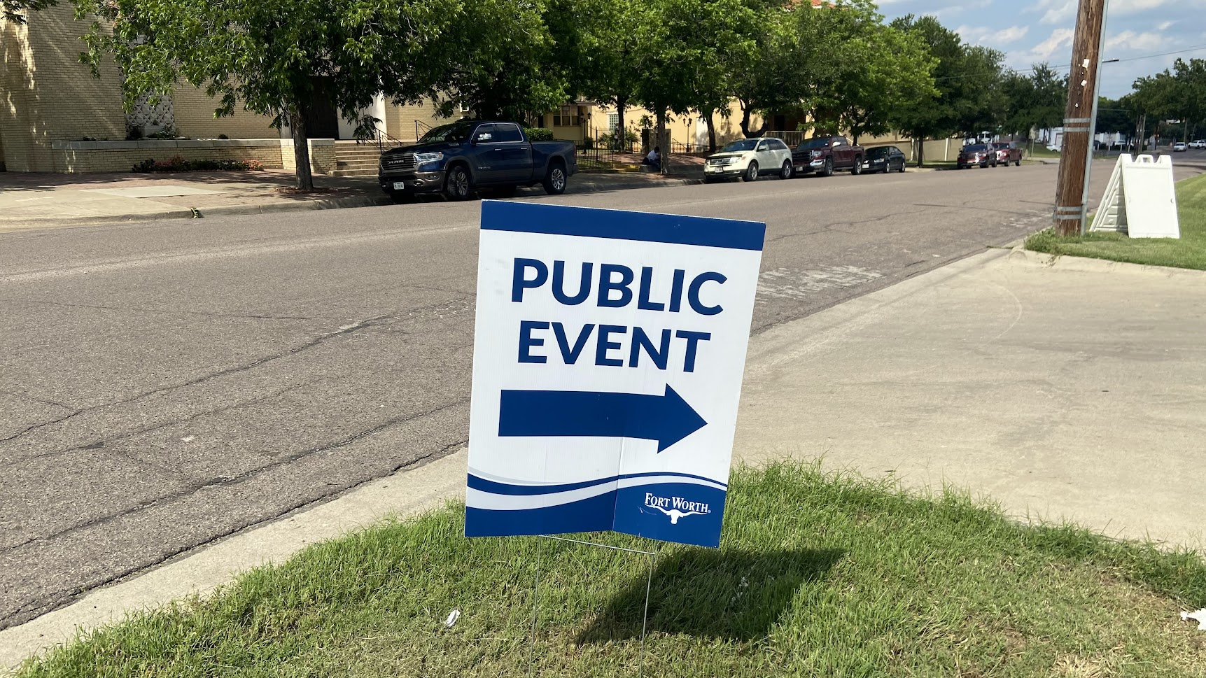
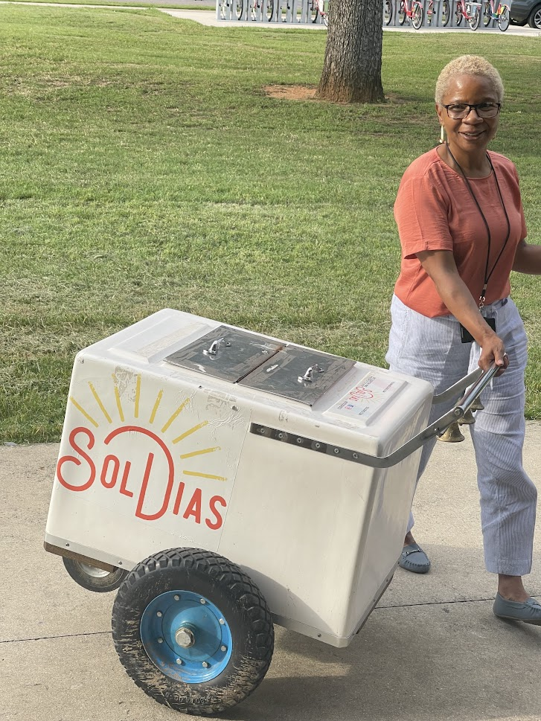
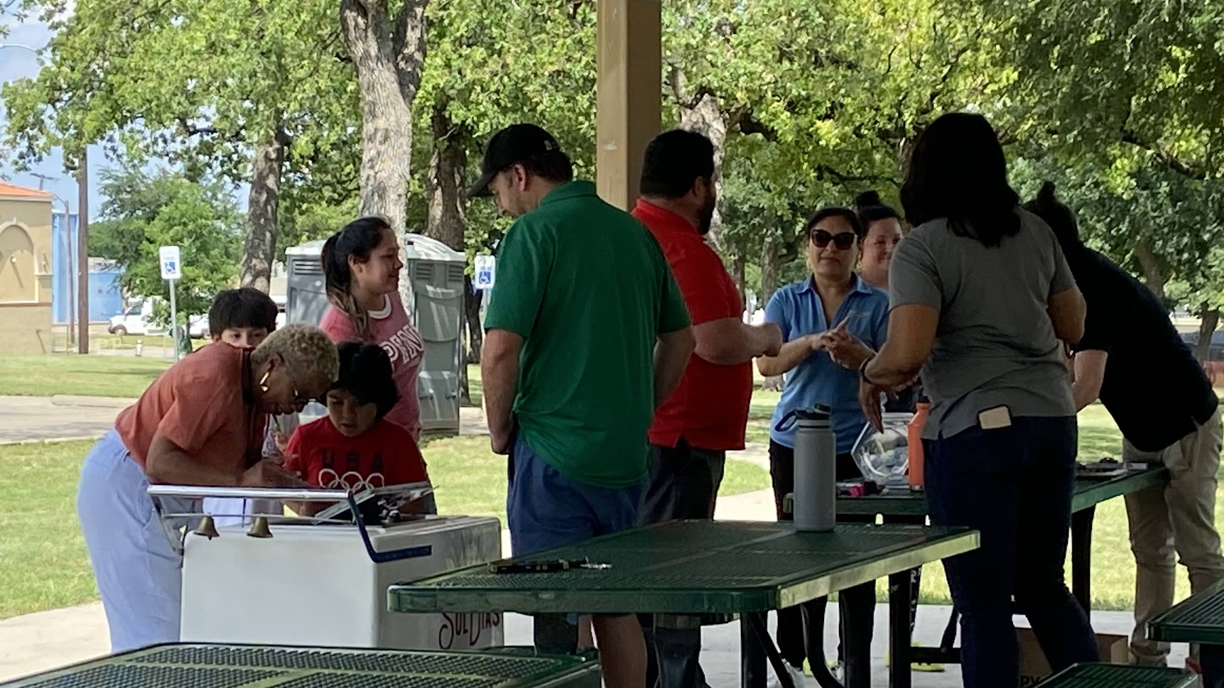
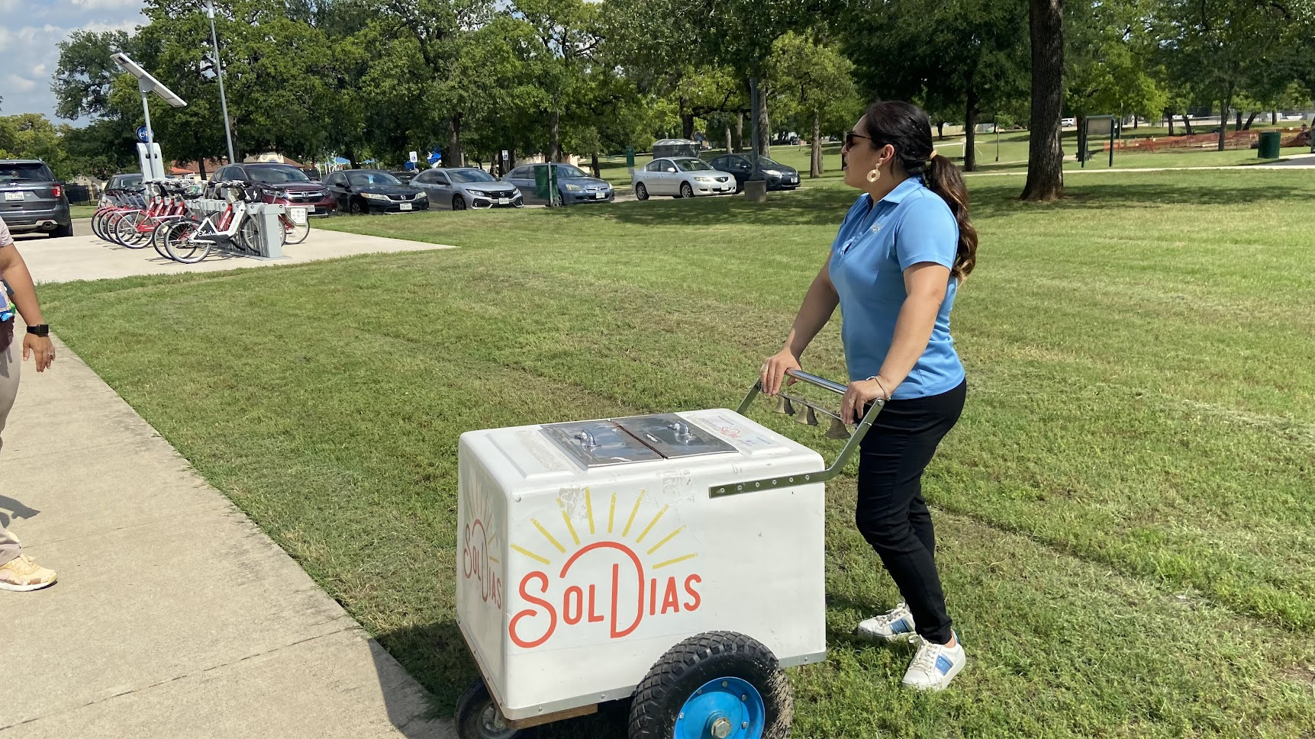
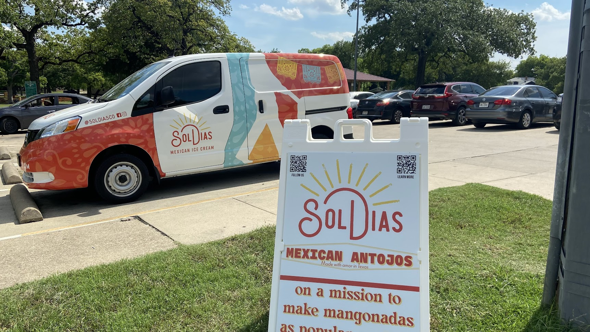
Outreach
Creative
Engaging
Flexible
Subliminal
Fun

Slide 5
Promoting Outreach Events
Social Media
Geofencing
Collaborating with Community Partners
Councilmembers
Video Advertising
Email Blast

Slide 6
Video
Putting Residents First: The Impact of Fort Worth's Priority Repair Program – YouTube

Slide 7
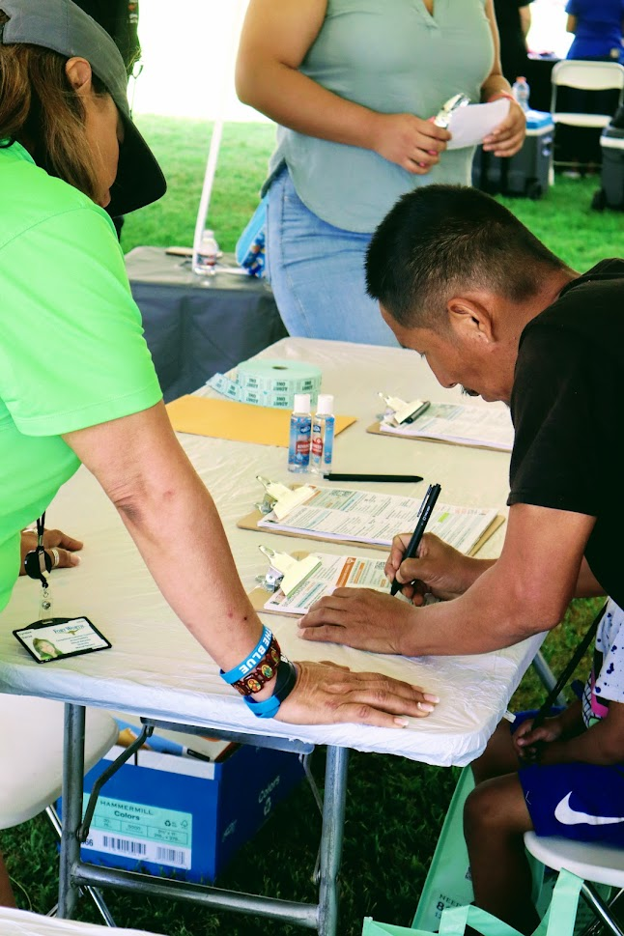
Public Meetings
No More Boring Meetings
Offer Information in Multiple Languages
Have Translators Present
Join Existing Community Meetings
Neighborhood Associations
Community Block Parties

Slide 8
Public Meetings
The Consolidated Plan 2023-2028 – YouTube

Slide 9
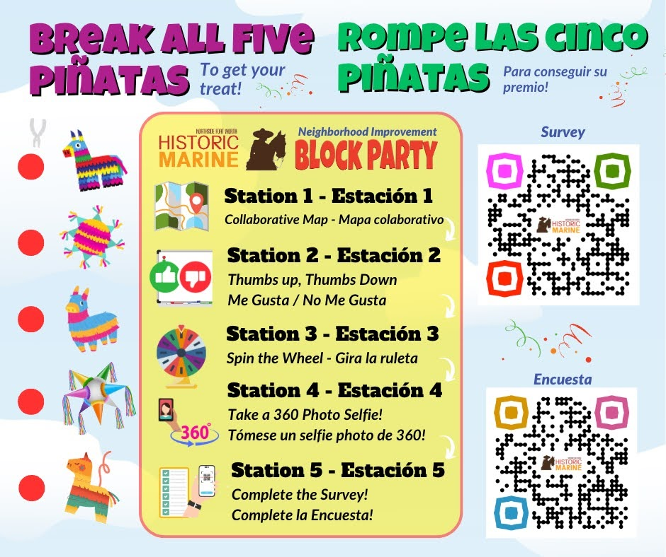
Interactive Activities

Slide 10
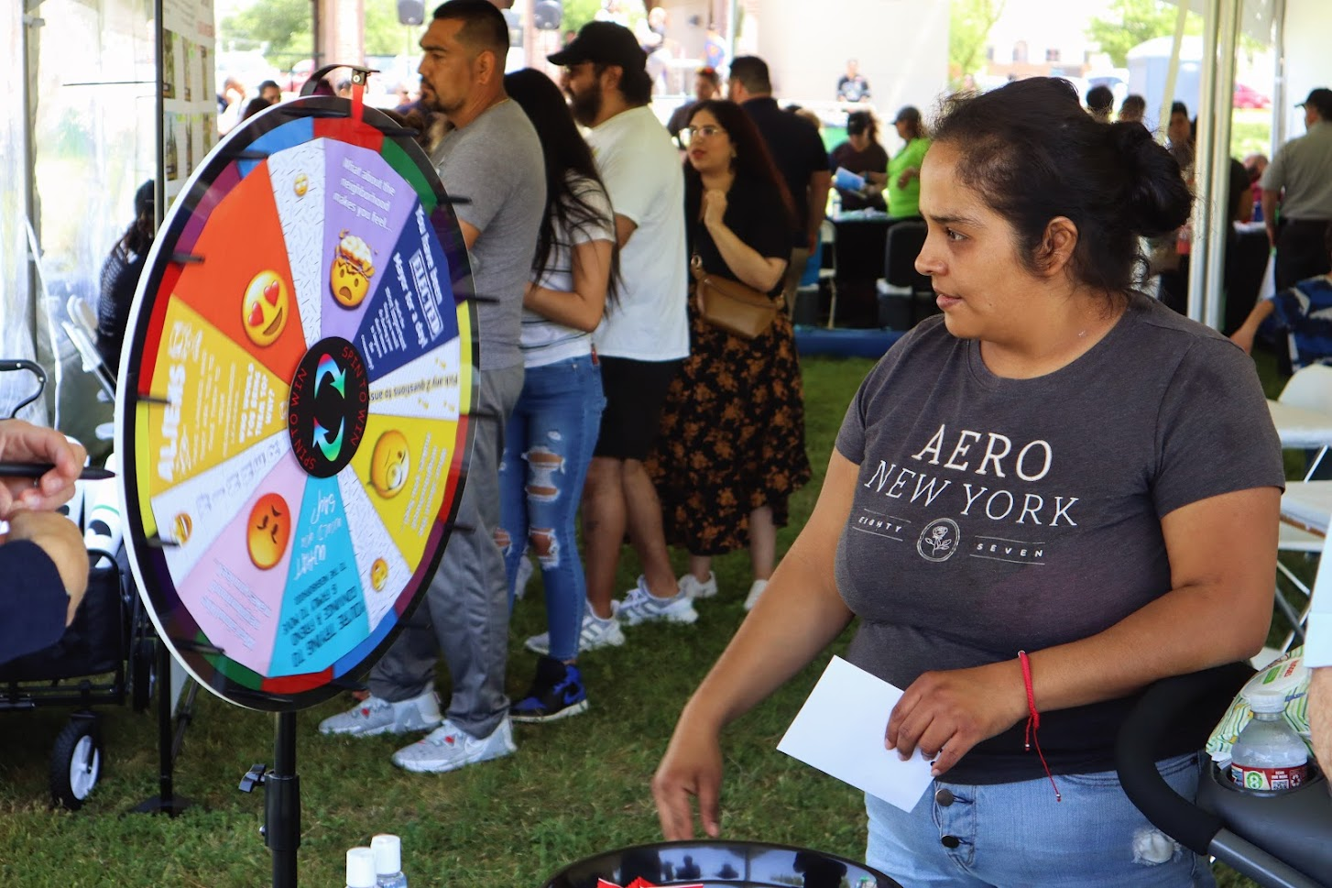
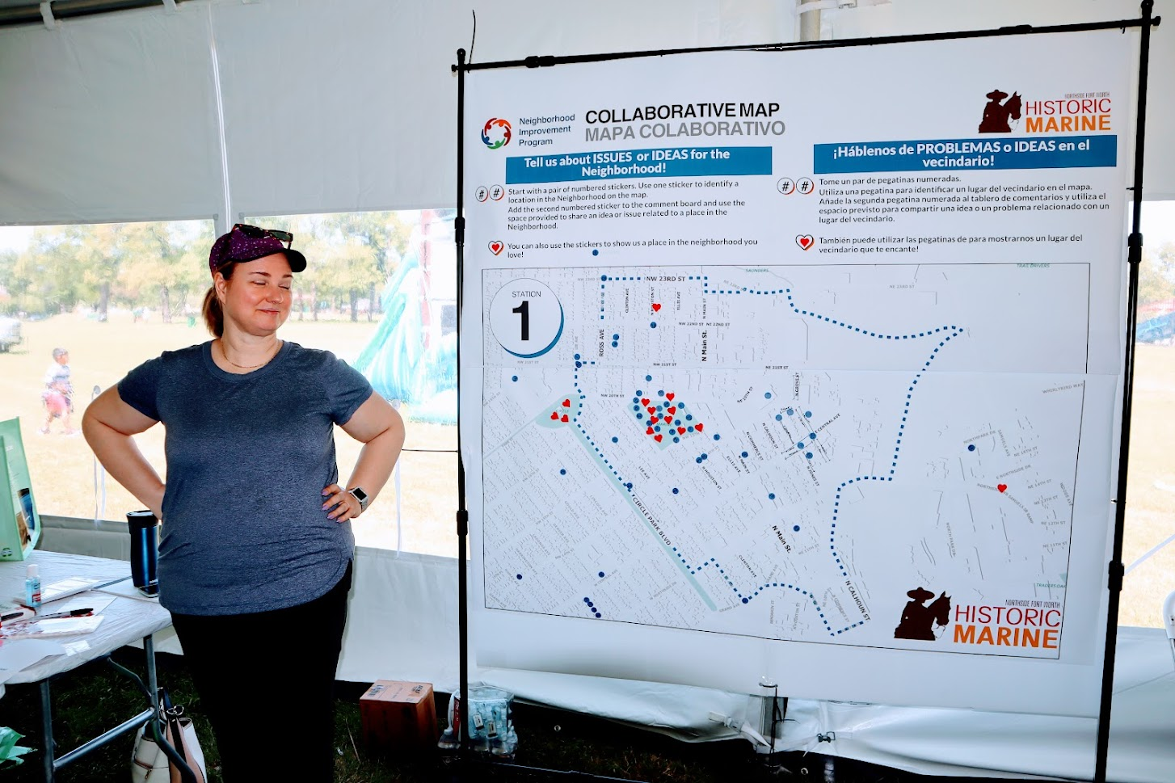
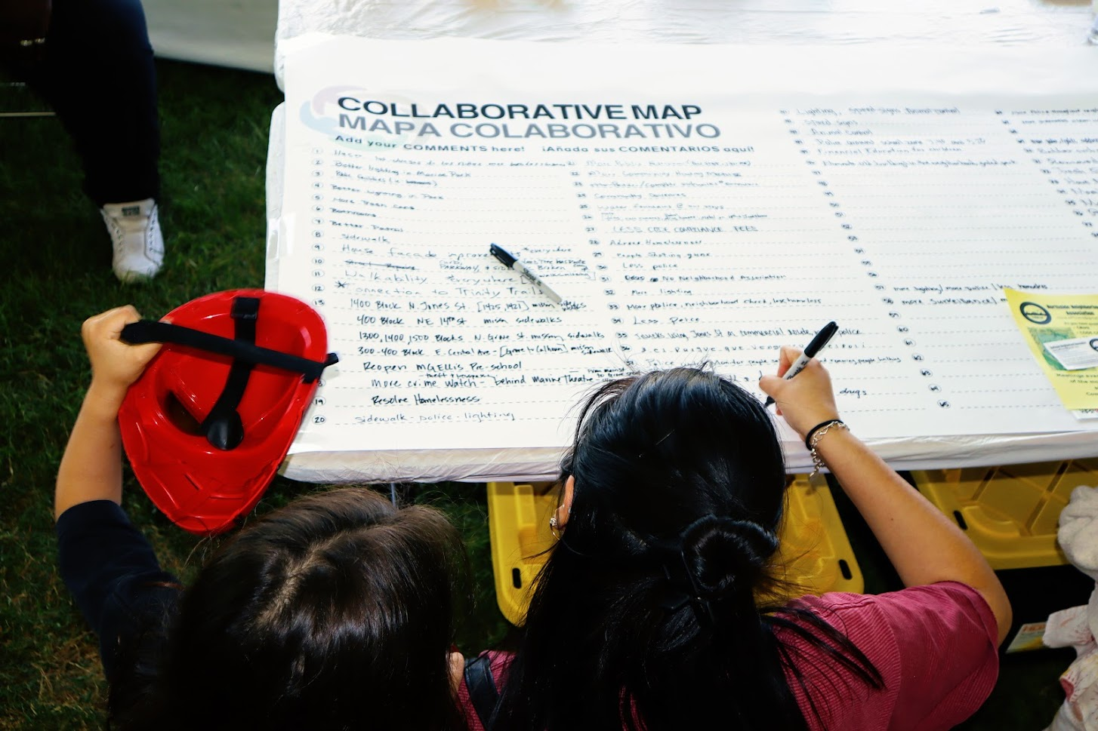
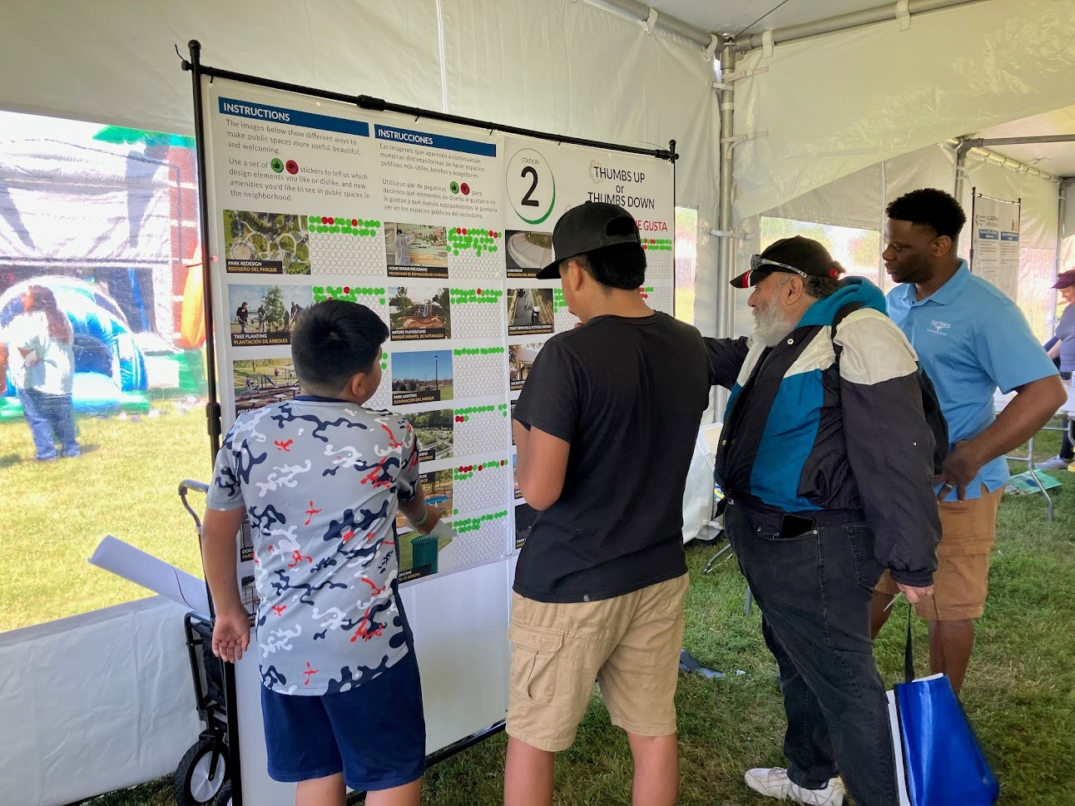
Interactive Activities

Slide 11
Interactive Activities
Historic Marine Block Party - April 15, 2023 - YouTube

Slide 12
Brand Guidelines: Click for full document

